Slide 1

Music Artist Classification Using CRNN
Sarthak Tandon
Dhrumil Shah

Slide 2
Introduction
Problem : Identify artists based on the audio file for given songs
Under the umbrella of Music Information retrieval
Similar problems :- music genre detection,music mood detection,song identification,chord recognition etc.
Artists detection is difficult because number of samples per artists is very limited.
Solving this problem would automate many things like music recommendation, detect copyright violations ,detect similar style artists etc.
Machine learning + Deep learning

Slide 3
Dataset & Preparation
artist20 dataset was created by Laboratory for the Recognition and Organization of Speech and Audio
Songs from 20 artists, each having 6 albums
Songs are transformed into mel-spectrograms to maintain temporal structure
“A spectrogram is a representation of frequency content over time found by taking the squared magnitude of the Fourier Transform of a signal.”
Features | Values
Size | 1.29 GB
No. of Tracks | 1413
No. of Artists | 20
Bitrate | 32kbps
Albums per Artists | 6
Parameters | Values
Sampling Rate | 16kHz
No. Mel Bins | 128
FFT Window size | 2048
Hop Length | 512
Power for Log-Scaling | 1.0

Slide 4
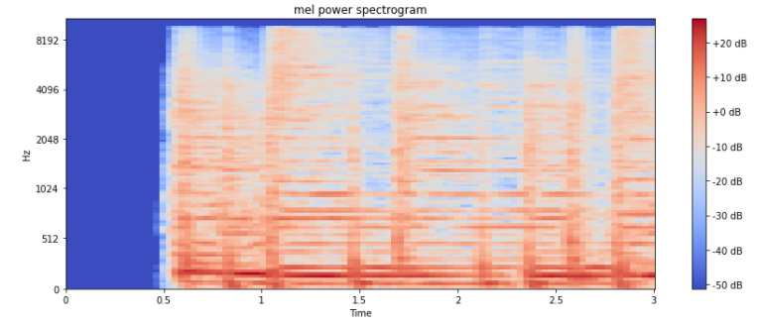

Slide 5
Dataset & Preparation
Data was split in two ways:
Song Split – Stratified Sampling (89/9/10)
Album Split – Leave Albums out (4/1/1)
Slice songs to "t" length based on the frame rate(31fps)
Encode Artists Classes
Label encoding
One hot Encoding

Slide 6
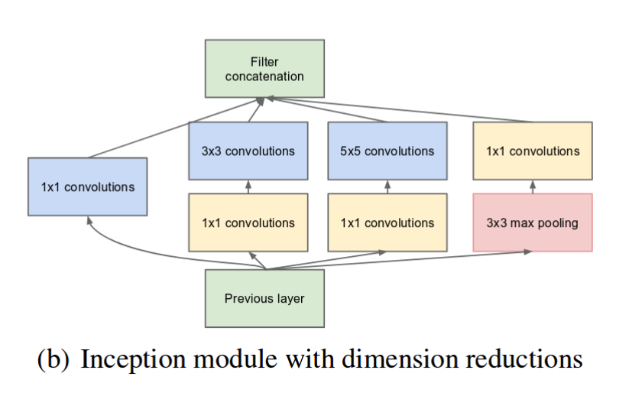
CRNN using Inception Block
Large kernel size – global features
Small Kernel size – local features
Inception Blocks have various kernel size and detect features at all levels.

Slide 7
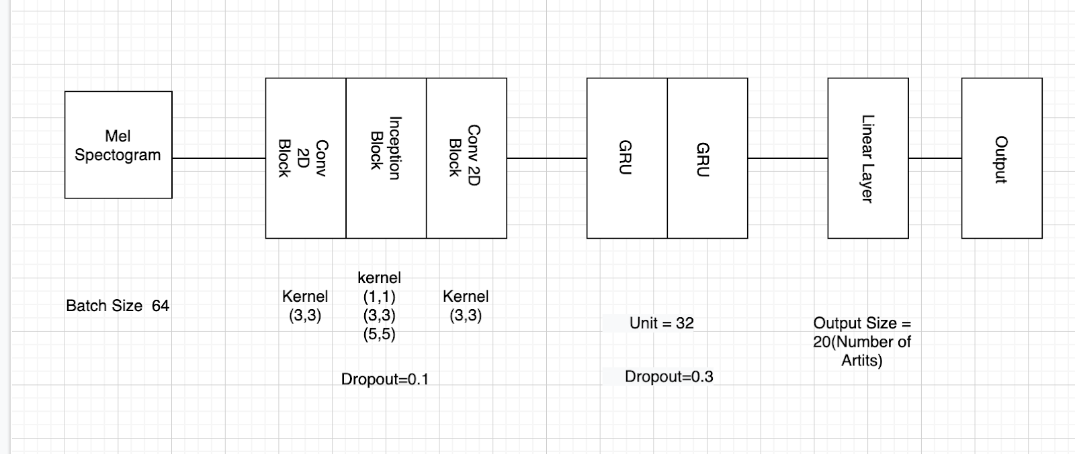
Architecture of CRNN

Slide 8
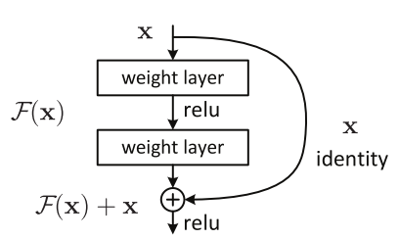
Residual Networks
Vanishing Gradient Problem with training of deep neural networks.
Solves by adding skip connections

Slide 9
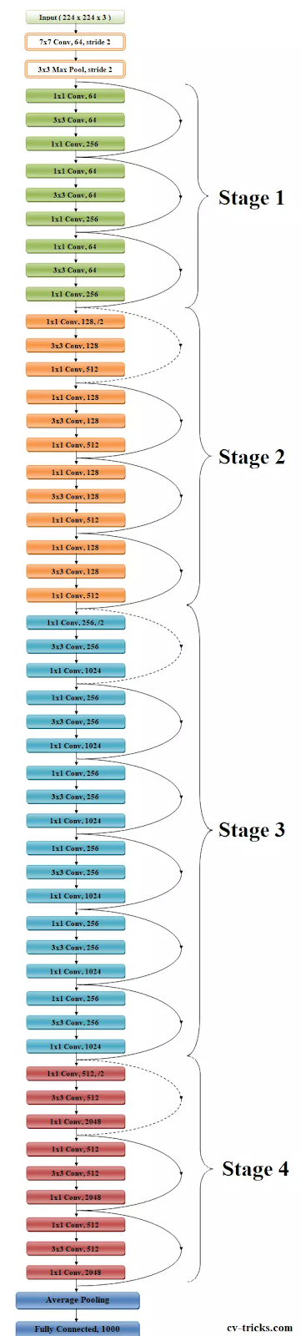
ResNet50 + RNN
Architectures of ResNet50
Frequency level features detected by first 3 stages of ResNet 50
Temporal features detected by the recurrent neural networks.
Output : probability distribution for each class

Slide 10
Training Considerations
Multi-Class Classification Problem
Loss Function – Cross Entropy Loss
Optimizer – Adam
Learning Rate – 0.0001
Epoch – 300
Metric – F1 Score

Slide 11
Result
Baseline Performance
Our Result
Average Test F1 scores for all Models
Authors | Feature Level | Split Type | Model | Accuracy
Whitman | Frame | Song | SVM | 0.5
Ellis | Frame | Album | GMM | 0.59
Mandel | Frame | Album | GMM | 0.541
Mandel | Frame | Album | SVM | 0.687
Mandel | Frame | Song | SVM | 0.839
Model | Split | 1s
Inception + RNN | Song | 0.5916
 | Album | 0.3689
Resnet 50 | Song | 0.592
 | Album | 0.354
Resnet 50 + RNN | Song | 0.6642
 | Album | 0.451
Average Test F1 scores from CRNN Model from U Toronto
Average Test F1 scores for Resnet50 + RNN Model
Split | F1 score 1s | F1 score 3s | F1 score 5s
Song | 0.729 | 0.765 | 0.770
Album | 0.482 | 0.513 | 0.536
Split | 1s | 3s | 6s
Song | 0.6642 | 0.6543 | 0.6792
Album | 0.451 | 0.5169 | 0.4873

Slide 12
Conclusion
Out of all the Models run, Resnet50+RNN was the best performing model
Song Level Split performed better than album level split
Model with 6s sample performed the best overall
Future work:
experimentation with extensive sample lengths,
looking at song level evaluation,
audio augmentation
further model improvements.

Slide 13
Thank You

